Slide 1
Composite Pattern Navy structure
Gruppe 4
Fatima Kodro, Daniel Hansen,
Søren Bech, Martin Andersen

Slide 2
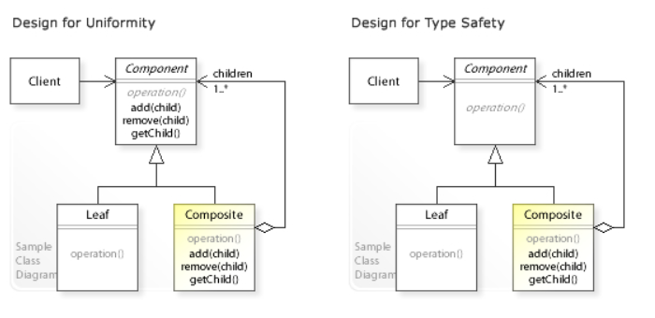
Structure

Slide 3
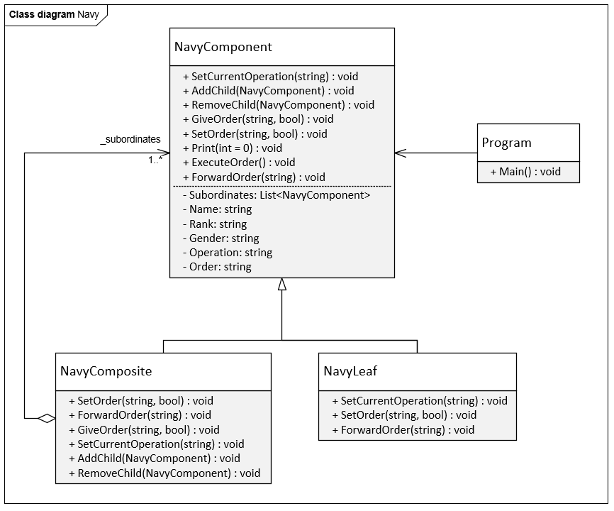
Example

Slide 4
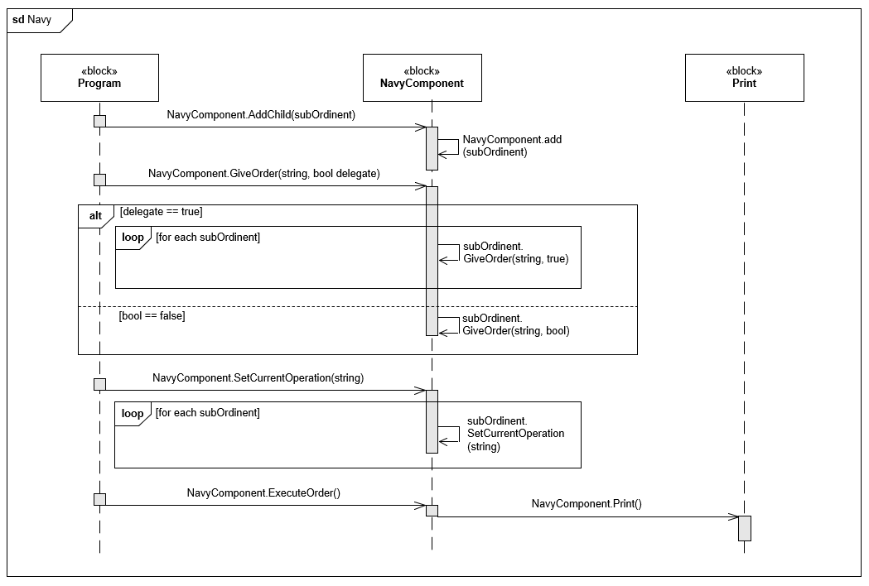
Sequence diagram

Slide 5
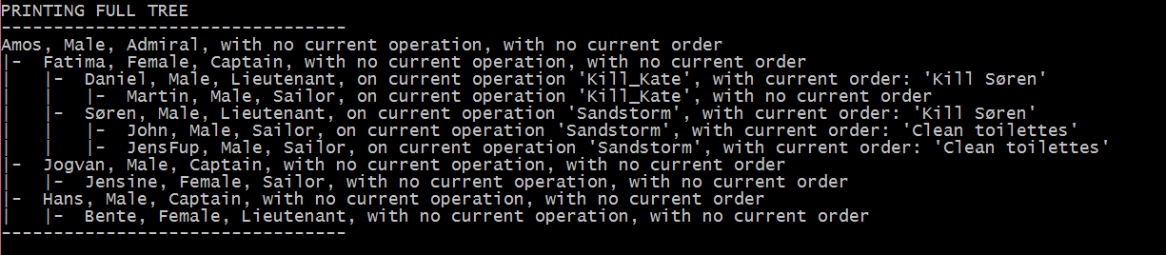
Tree structure

Slide 6
Conclusion
Generic: Good for tree structures with the same overall type
Some draw backs: Bad if wanting to extend

